Slide 1
Pytorch
Cse case study

Slide 2
Team Members
Kaaran reddy
Nitin Krishna
Ronald rick
Santhosh kumar

Slide 3
Objectives
Problem solving and Arithmetic thinking.
Use of Data Structures
Modular designs (Functions and packages)
File Handling

Slide 4
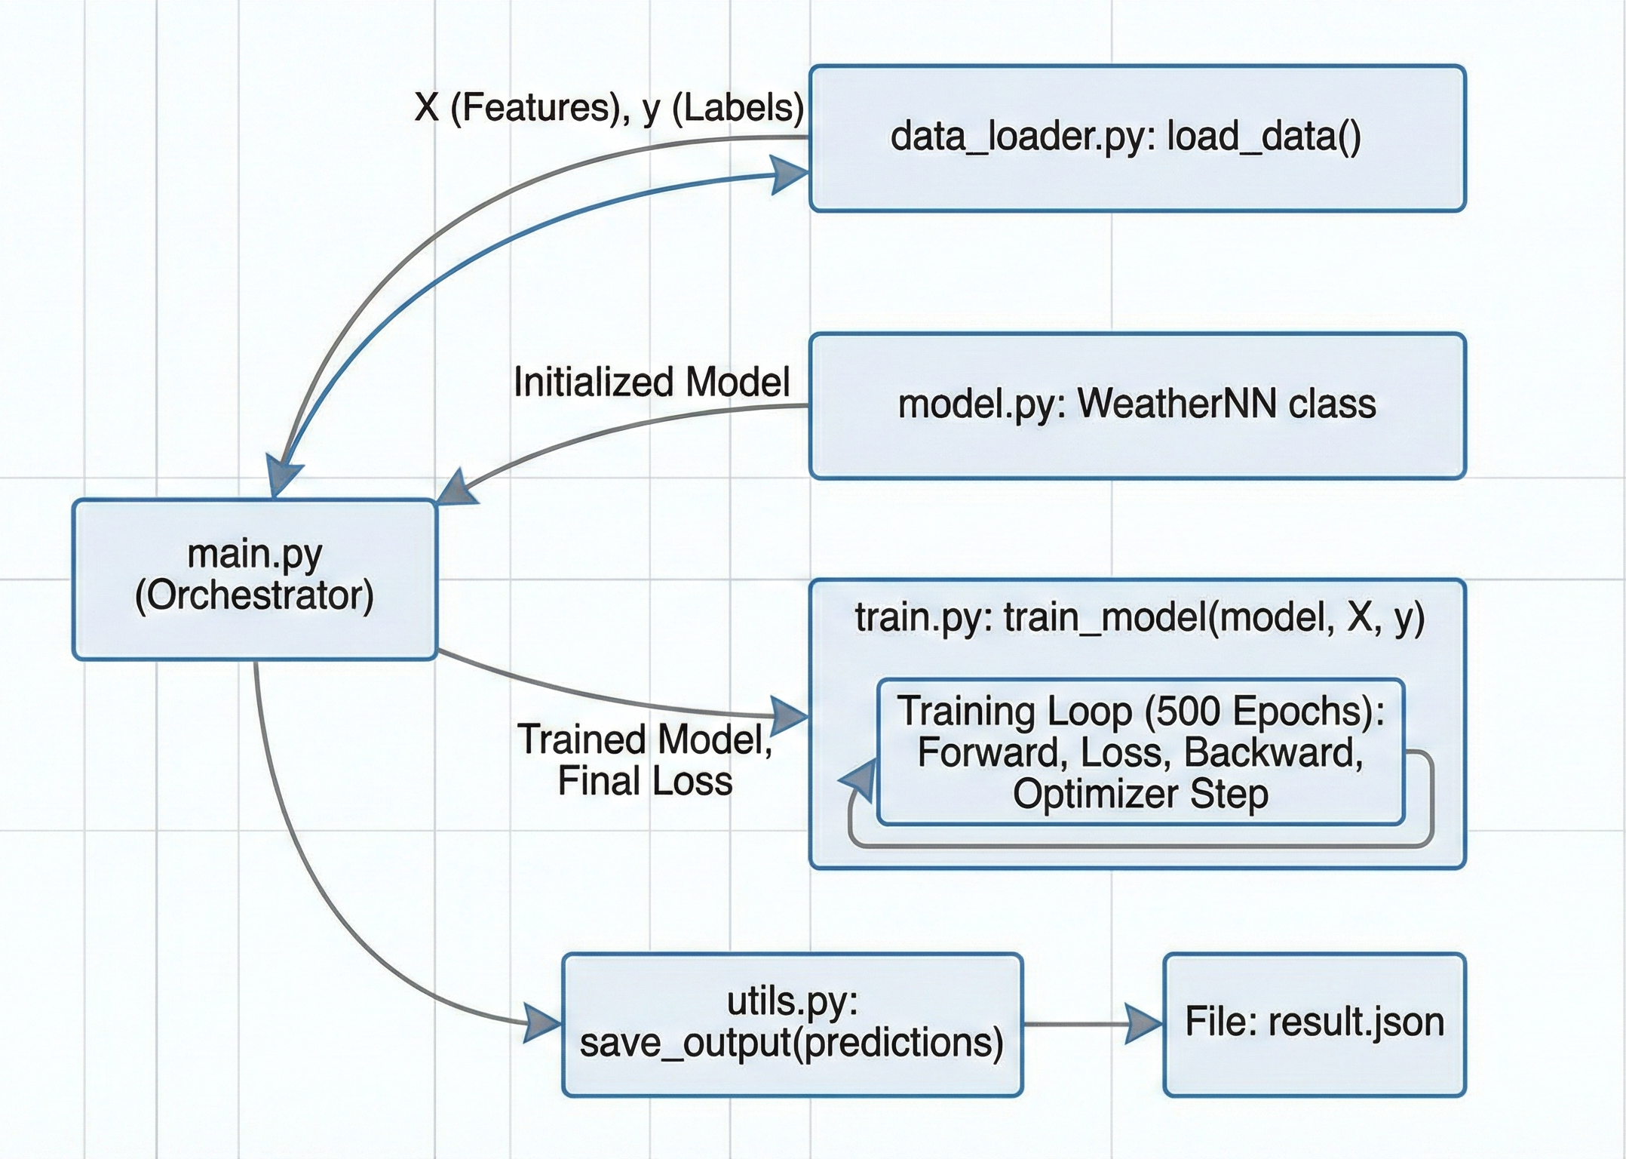
Code Walkthrough

Slide 5
Thank you

